Slide 1

GREEN FINGERS

Slide 2


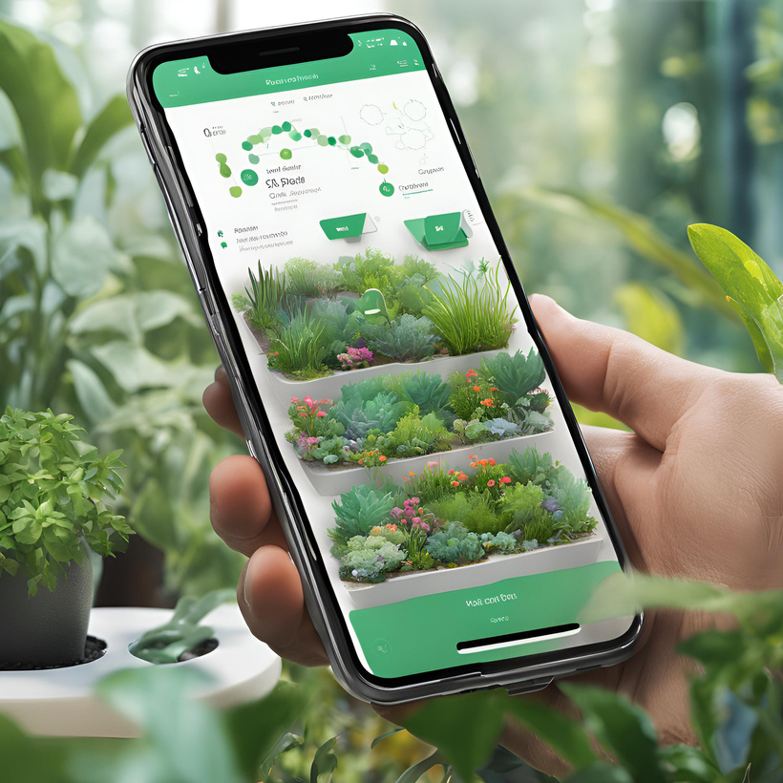

OUR VISION
Integrating software and hardware tools to manage both indoor and outdoor garden
AUTOMATION & SMART FEATURES
GUIDANCE & INFORMATION
EFFICIENT GARDEN MANAGEMENT

Slide 3
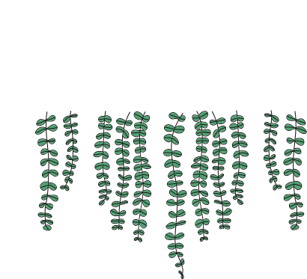



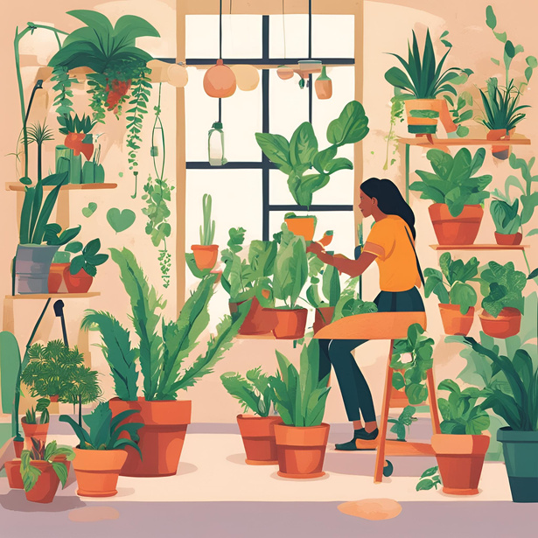

SCOPE
USERS
DEVELOP FOR:
plants Lover
ADMINS
It aims to assist gardeners in tracking plant care through features like adding plants, managing watering schedules, receiving notifications, and integrating sensor data.

Slide 4

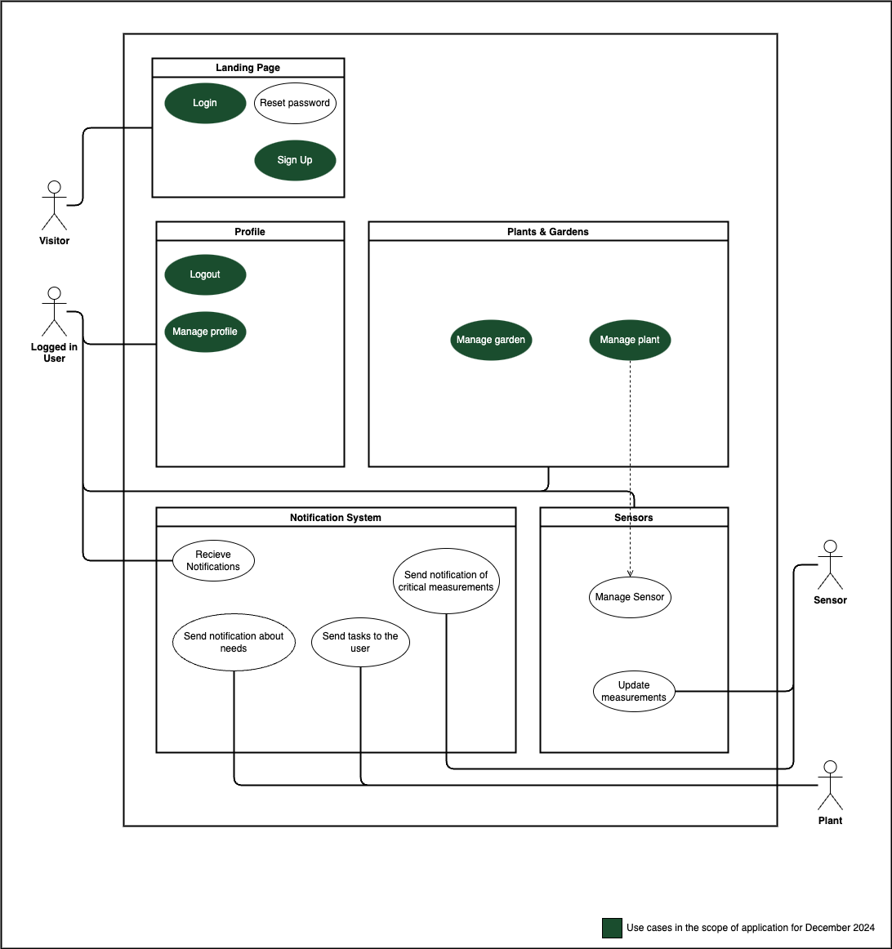
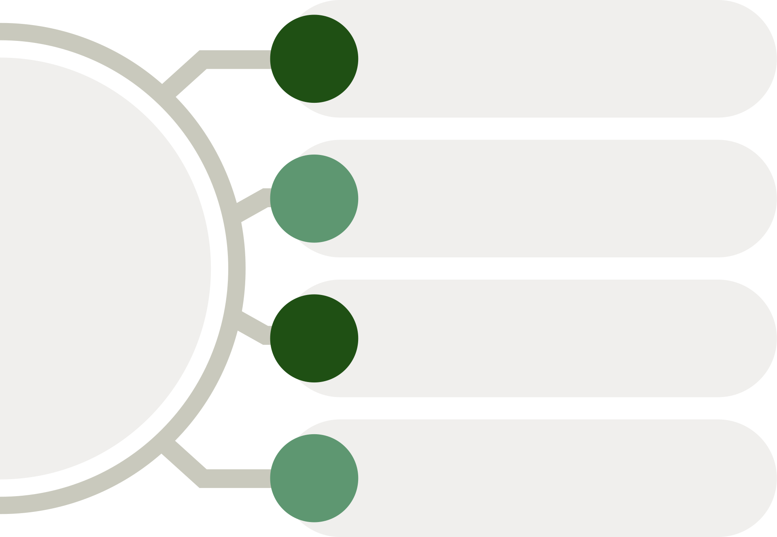
USE CASE
DIAGRAM
add
Manage
plant
delete
view
edit
add
delete
Manage
garden
view
edit
add
delete
Manage User
view
edit

Slide 5
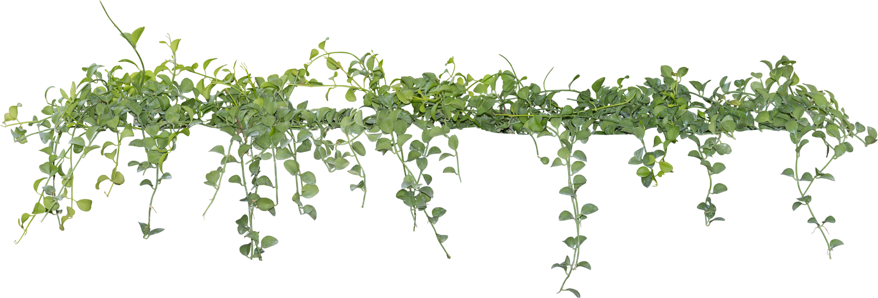
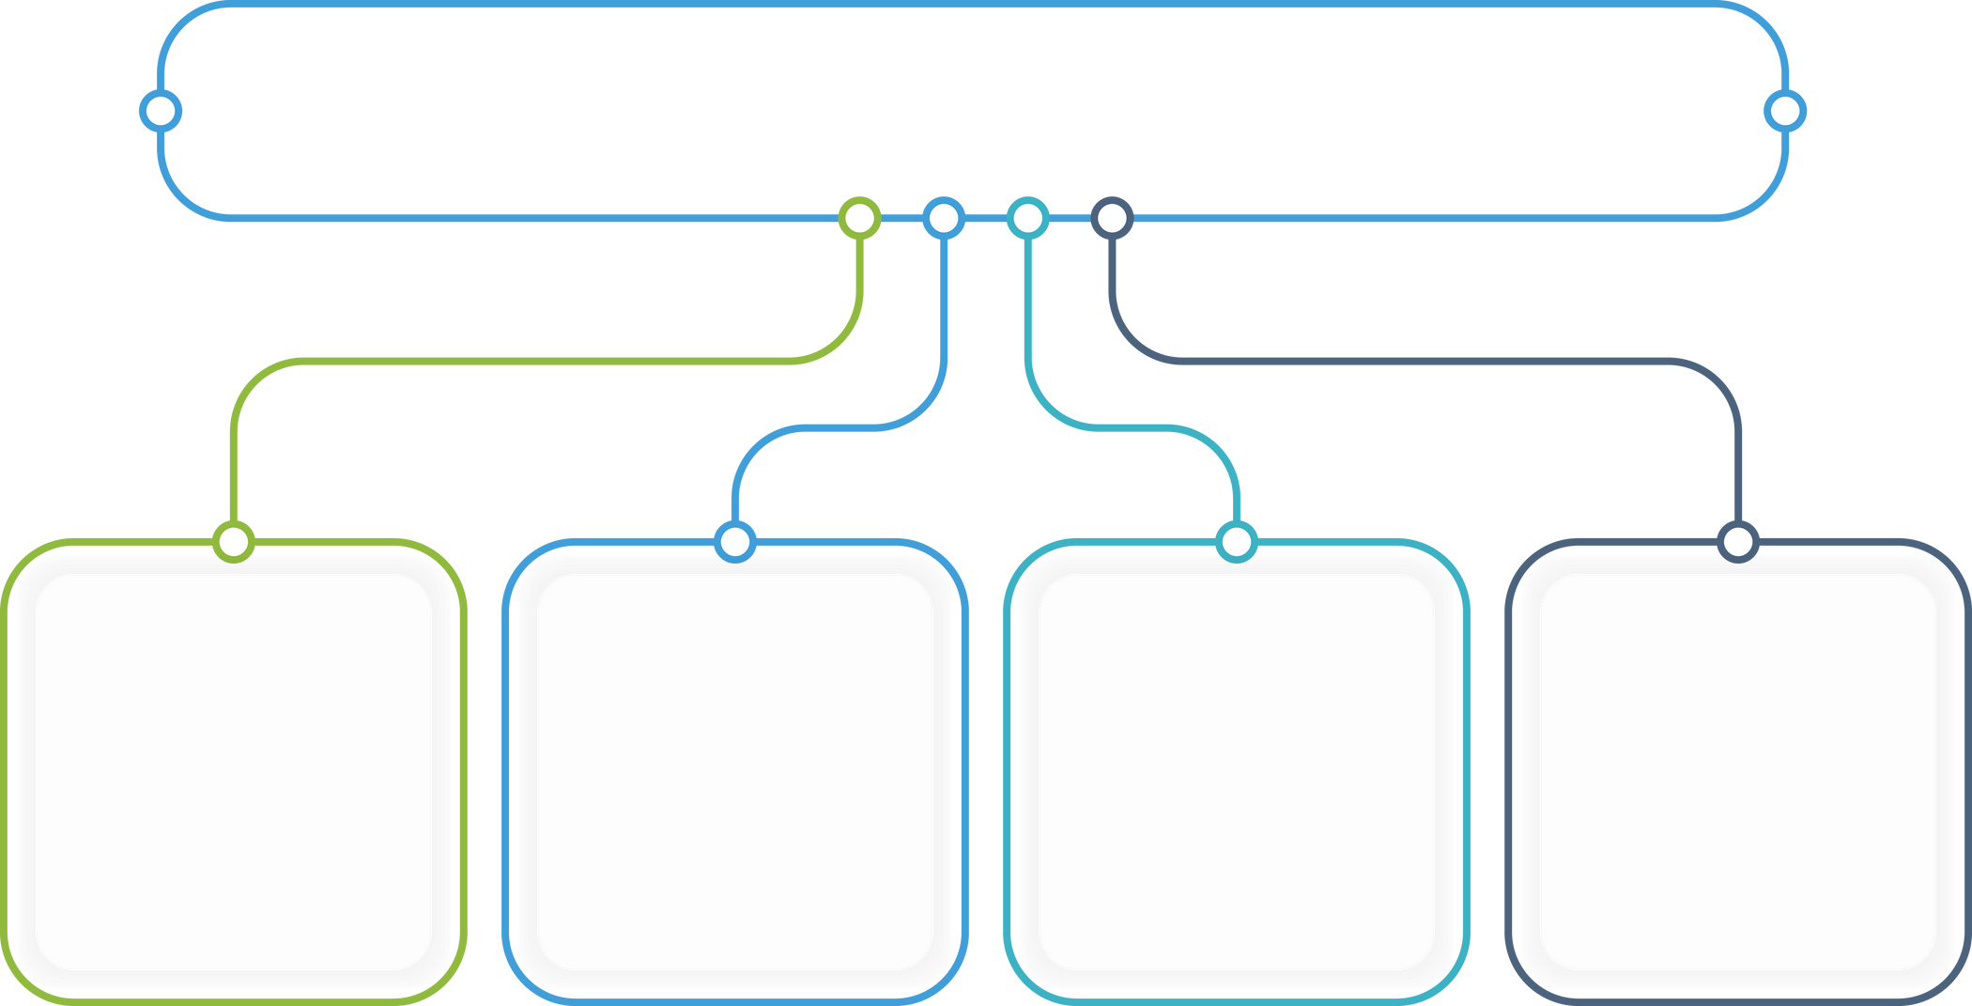
FUNCTIONAL AND NON-FUNCTIONAL USE CASES
Non-functional
Use cases
functional Use cases
Add
garden
&
plant
edit
garden
&
Plant
Delete
garden
&
plant
search for plants
update
measurements
delete
user profile
Manage
Sensor
Notification
System

Slide 6








Project Management
every week
code review
Sprint Review
Team working on the new Ideas
product

Slide 7


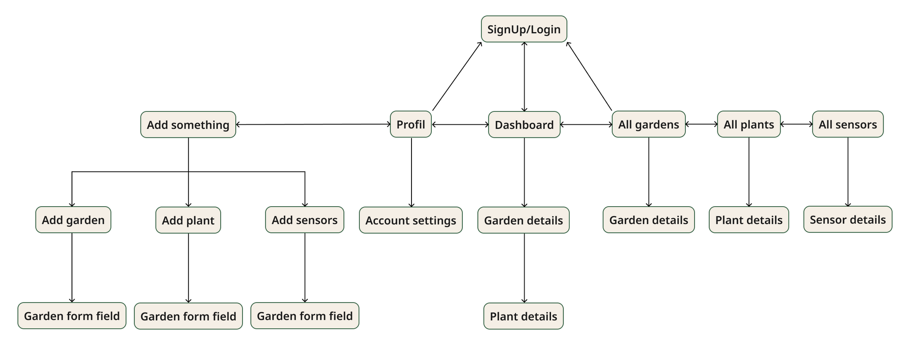



long-term planning

Slide 8

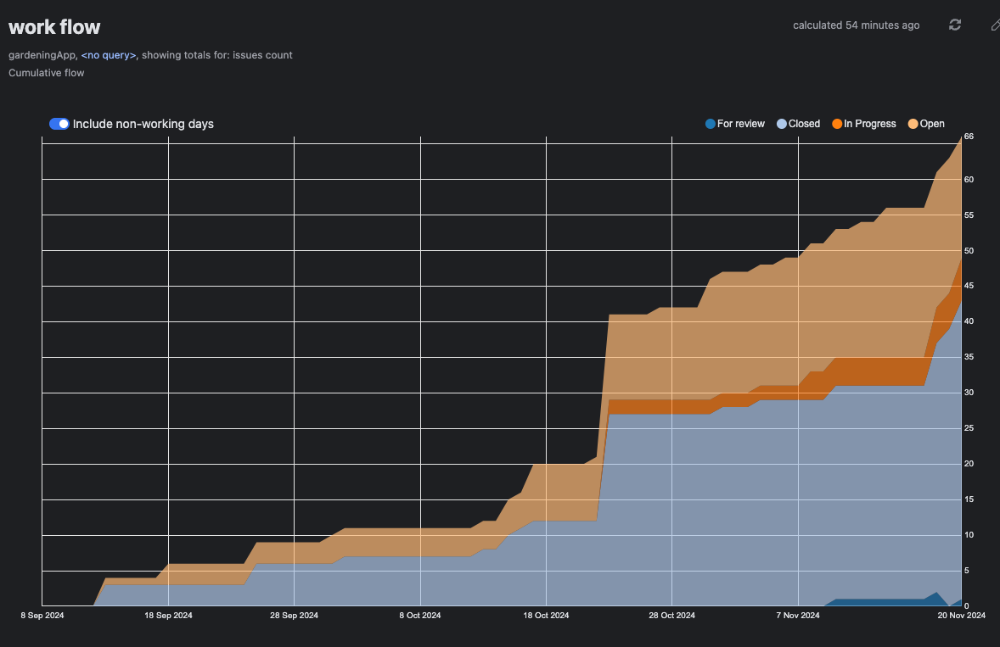
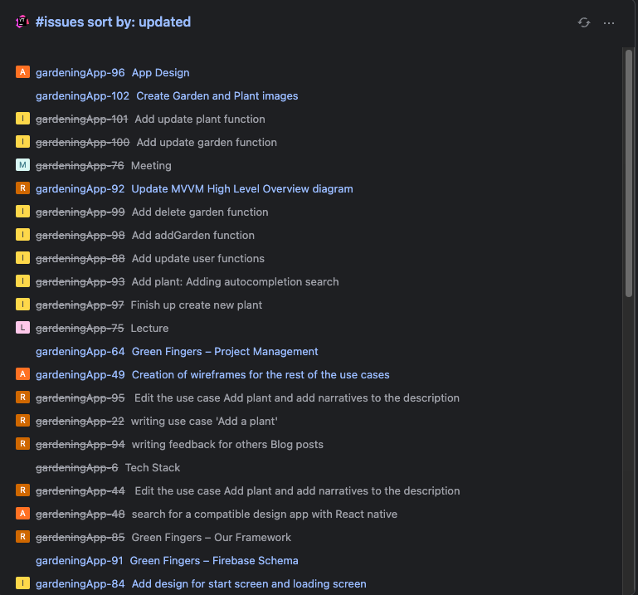
Our YouTrack Link

Slide 9
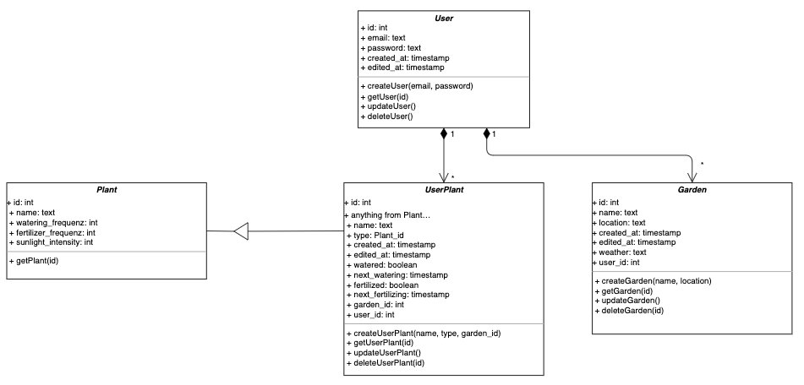
Class diagram

Slide 10
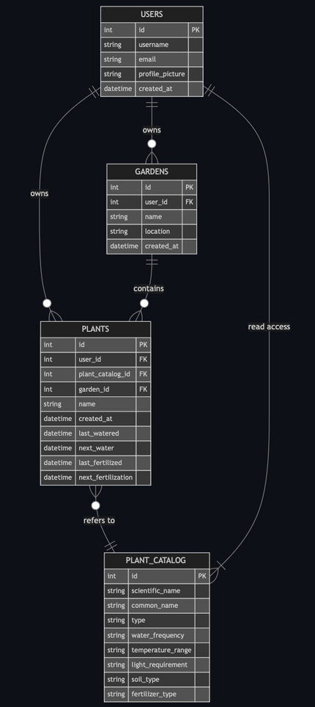
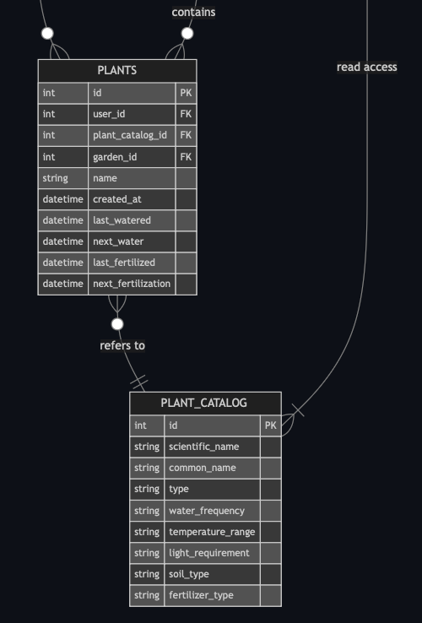
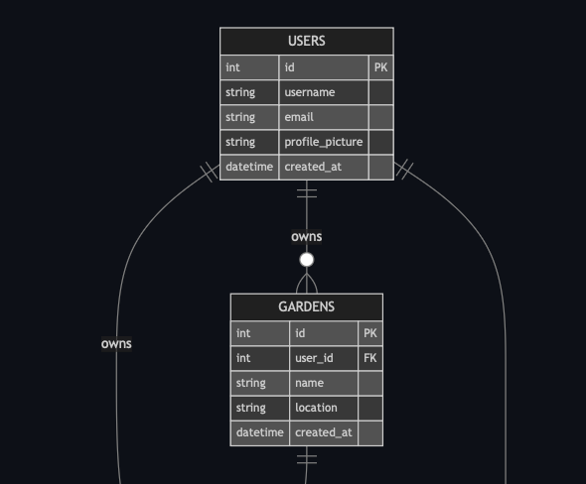
Database Diagram

Slide 11
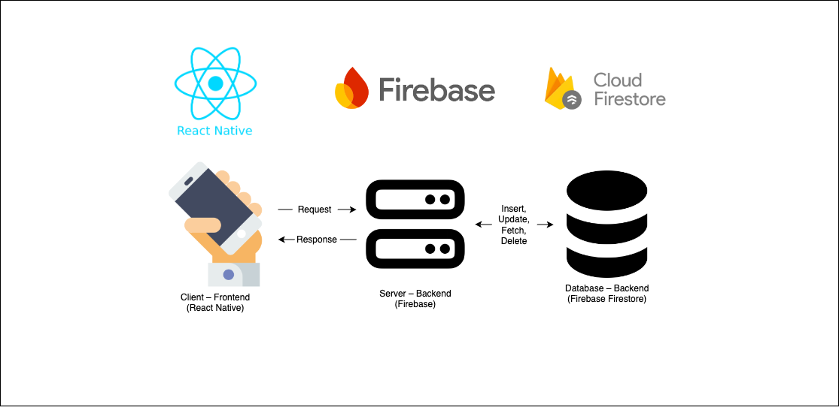

MVVM architecture & TeckStack
View
ViewModel
Model

Slide 12
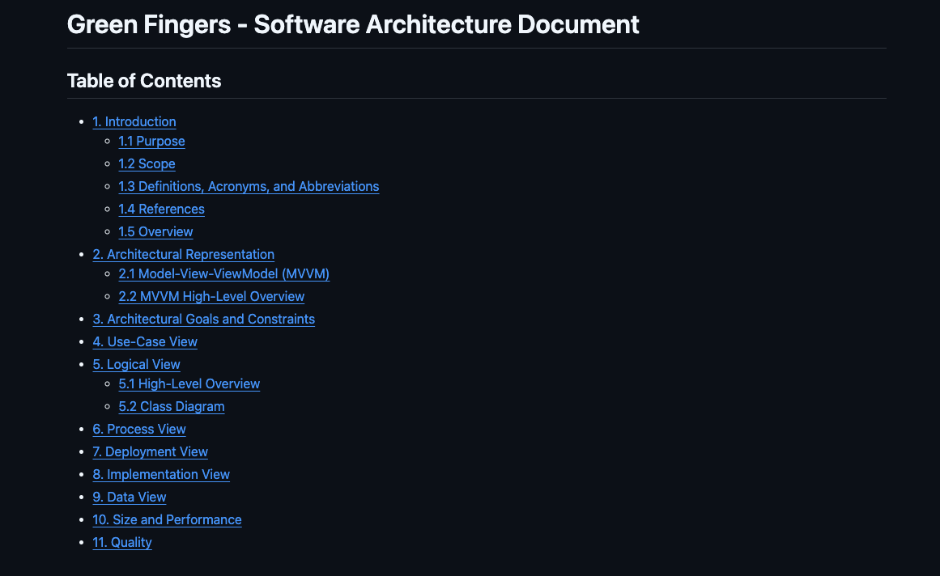
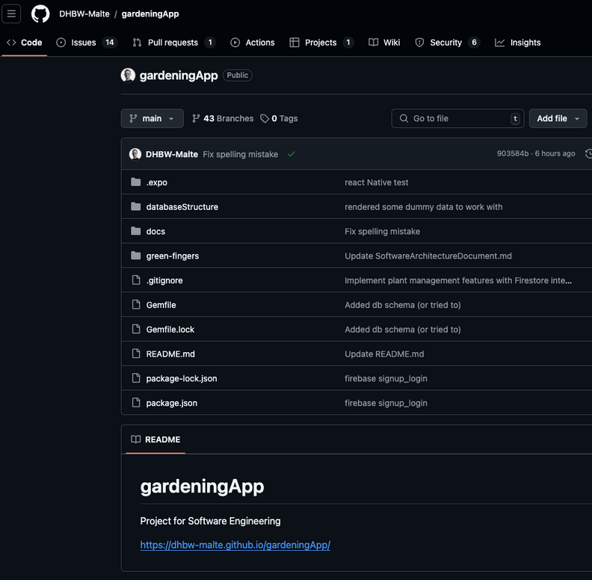
link to SAD
link to GitHub

Slide 13


